Slide 1
MARKETING ANALYTICS
SESSION 12
CUSTOMER RETENTION MODELS AND LIFETIME VALUE
Professor Sonnier
Texas MSBA Program
Fall 2022

Slide 2
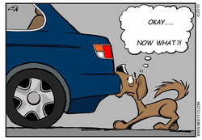
MARKETING ANALYTICS I
We Acquired a Customer!

Slide 3
MARKETING ANALYTICS I
The Essence of Marketing
Customer
Acquisition
Customer
Retention
“The purpose of a business is to create and keep a customer. To do that you have to produce and deliver goods and services that people want and value at prices and under conditions that are reasonably attractive relative to those offered by others to a proportion of customers large enough to make those prices and conditions possible.”
-- Theodore Levitt, “Marketing and the Corporate Purpose” in The Marketing Imagination (New York: Free Press), 1986.

Slide 4
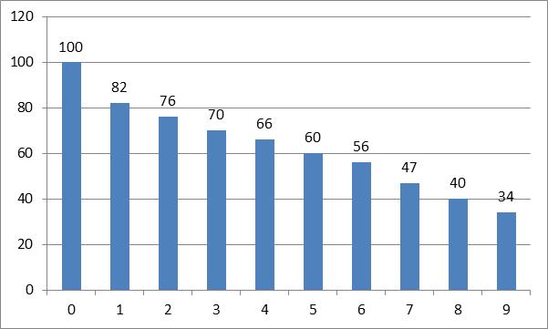
PROFIT AND RETENTION PATTERNS FOR A CREDIT CARD COMPANY
Retention Probability Over Time
Year | Profit per Customer | Annual Retention Probability
0 |  | 100%
1 | $42 | 82%
2 | $66 | 93%
3 | $70 | 92%
4 | $75 | 94%
5 | $86 | 91%
6 | $92 | 93%
7 | $96 | 84%
8 | $99 | 85%
9 | $105 | 85%
Totals
Probability a Customer Remains by Age
Age of Customer Account (years)
If r is constant

Slide 5
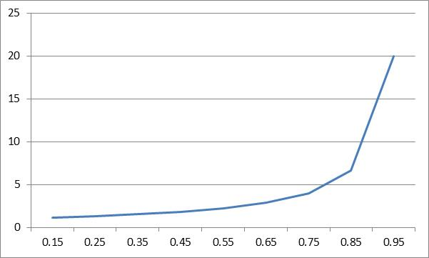
EXPECTED LIFE (EL) OF A CUSTOMER
Finite and Infinite Planning Horizons
Finite Horizon (T), Alive Every Period with Certainty
Finite Horizon (T), Constant Probability of Churning
Infinite Horizon (T), Constant Probability of Churning
Expected Lifetime
Retention Rate

Slide 6
CUSTOMER RETENTION
A rose by any other name…
Churn Rates by Industry and Country
 | France | United States | United Kingdom
Grocery | 34% | 32% | 27%
ISP | 22% | 38% | 24%
Mobile | 21% | 11% | 38%
Bank | 16% | 25% | 18%
Insurance | 16% | 12% | 25%
Credit Card | 7% | 20% | 16%
Utility | 1% | 12% | 7%
Source: Boobier, Keeping the Customer Satisfied (2013)

Slide 7
CHURN AND RETENTION FOR SUBSCRIPTION BASED BUSINESSES
Computing Retention and Churn for Netflix
We start Q2-2002 with 562,000 subscribers (Q1-2002 # of Subscribers)
In Q2-2002 we added 236,000 subscribers (for a total of 798,000)
We end Q2 with 598,000 subscribers
Thus, (562+236)-598=200 churned
Churn rate=200/562=36%
Retention rate=1-Churn Rate=64%

Slide 8
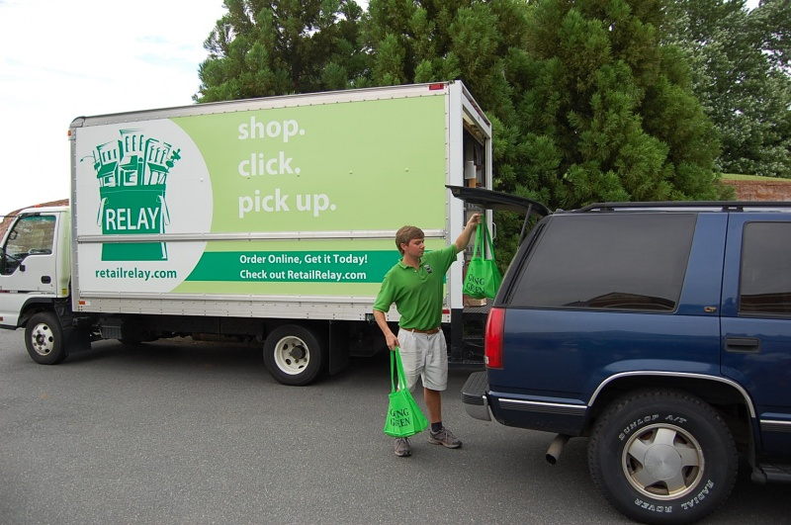
PREDICTING CHURN AT RETAIL RELAY
What Does Retail Relay Do?

Slide 9
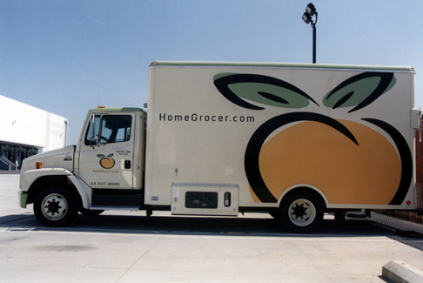
IN THE BEGINNING, THERE WAS HomeGrocer.com
Would you like to have something to eat?

Slide 10
PREDICTING CHURN AT RETAIL RELAY
What Does Retail Relay Do?
Online grocer
Delivers orders to central location
Customer pick up orders

Slide 11
PREDICTING CHURN AT RETAIL RELAY
Can We Understand Churn?
How do we think about churn for a non-subscription business?

Slide 12
PREDICTING CHURN AT RETAIL RELAY
Can We Understand Churn?
For each customer with at least 3 purchases, RR knows the average inter-purchase time
Purchase
Duration (in mos.)
1
2
3
4
5
Time between 2nd purchase and 1st purchase is 1 month
Time between 3rd purchase and 2nd purchase is 2 months
Now we can compute the average inter-purchase time and the std. deviation of the inter-purchase time
If customer’s last inter-purchase interval is greater than 2 std. deviations away from the mean, RR classifies the customer as churned

Slide 13
PREDICTING CHURN AT RETAIL RELAY
Let’s Look at the Data
Download Retail Relay data from Session 12 Folder
Examine the data
What’s the average churn rate?
What’s the average duration?

Slide 14
PREDICTING CHURN AT RETAIL RELAY
Can We Understand Churn?
The average churn in the sample is 15%

Slide 15
PREDICTING CHURN AT RETAIL RELAY
Can We Understand Churn?
As a function of duration?
As a function of marketing?

Slide 16
PREDICTING CHURN AT RETAIL RELAY
Let’s Look at Customer Duration

Slide 17
PREDICTING CHURN AT RETAIL RELAY
Possible Relationships Between Churn and Duration?
Churn
?
Duration

Slide 18
PREDICTING CHURN AT RETAIL RELAY
Possible Relationships Between Churn and Duration?
Churn
Duration
Churn becomes increasingly likely over the customer’s life

Slide 19
PREDICTING CHURN AT RETAIL RELAY
Possible Relationships Between Churn and Duration?
Churn
Duration
There is no relation between churn and duration

Slide 20
PREDICTING CHURN AT RETAIL RELAY
Possible Relationships Between Churn and Duration?
Churn
Duration
Churn becomes decreasingly likely over the customer’s life

Slide 21
PREDICTING CHURN AT RETAIL RELAY
Build a Simple Logit Model to Predict Churn
Start with a model that just uses duration (duration tab in workbook)
Estimate the model
Use the model to compute churn probability for observed durations (or just use the ones computed for you by software)
Sort predictions by increasing duration
Graph your data. What do you conclude?

Slide 22
PREDICTING CHURN AT RETAIL RELAY
Build a Simple Logit Model to Predict Churn
Churn as a function of duration

Slide 23
PREDICTING CHURN AT RETAIL RELAY
Possible Relationships Between Churn and Duration?
Churn
?
Duration

Slide 24
PREDICTING CHURN AT RETAIL RELAY
Possible Relationships Between Churn and Duration?
Churn
Duration
Churn risk increases, peaks, then declines

Slide 25
PREDICTING CHURN AT RETAIL RELAY
Possible Relationships Between Churn and Duration?
Churn
Duration
Churn risk decline, bottoms out, then increases

Slide 26
PREDICTING CHURN AT RETAIL RELAY
Build a Logit Model to Predict Churn
How would we capture inverted U shape or U shape response?
Estimate the model
Use the model to compute churn probability for observed durations
Sort predictions by increasing duration
Graph your data. What do you conclude?

Slide 27
PREDICTING CHURN AT RETAIL RELAY
Build A Model to Predict Churn
Churn as a function of duration and duration^2

Slide 28
PREDICTING CHURN AT RETAIL RELAY
What Have We Learned So Far?
The relationship between churn and duration seems to follow a U-shaped pattern
Young accounts are at higher risk
Risk declines as accounts age
Risk begins to climb again for oldest accounts
How does marketing effort impact churn?

Slide 29
PREDICTING CHURN AT RETAIL RELAY
What About Marketing?

Slide 30
PREDICTING CHURN AT RETAIL RELAY
Adding Marketing to the Model
What happens to duration?
Does marketing matter?

Slide 31
PREDICTING CHURN AT RETAIL RELAY
What About Marketing?

Slide 32
PREDICTING CHURN AT RETAIL RELAY
Adding Marketing to the Model
What is the churn probability for someone with an 18 month duration who gets 1 email per month?
How does the churn probability change if the rate increases to 1.1 emails per month?
How does the churn probability change if the rate increases to 1.2 emails per month? 1.3 emails per month? 1.4? 1.5?
How do your results change for a duration of 24 months? 30 months?

Slide 33
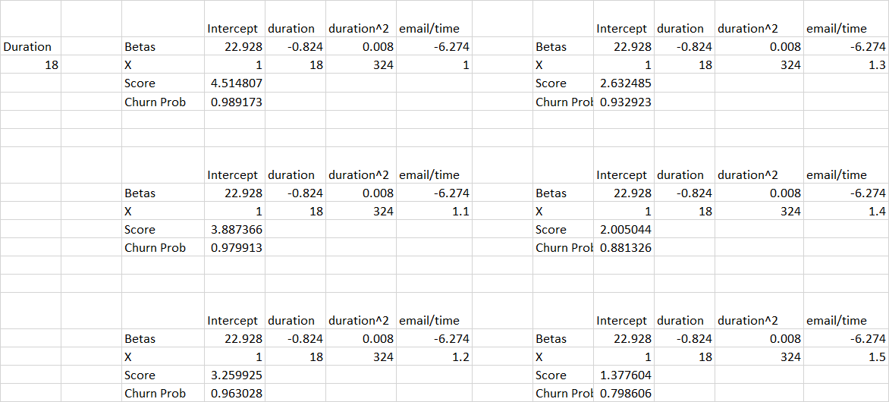
PREDICTING CHURN AT RETAIL RELAY
The Effect of Increased Marketing Effort: 18 Month Duration

Slide 34
PREDICTING CHURN AT RETAIL RELAY
The Effect of Marketing: 18 Month Duration

Slide 35
PREDICTING CHURN AT RETAIL RELAY
The Effect of Marketing: 24 Month Duration

Slide 36
PREDICTING CHURN AT RETAIL RELAY
The Effect of Marketing: 30 Month Duration

Slide 37
CUSTOMER LIFETIME VALUE
Retention Impacts Customer Lifetime
Year | Profit per Customer | Annual Retention Probability
0 |  | 100%
1 | $42 | 82%
2 | $66 | 93%
3 | $70 | 92%
4 | $75 | 94%
5 | $86 | 91%
6 | $92 | 93%
7 | $96 | 84%
8 | $99 | 85%
9 | $105 | 85%
Totals
Probability a Customer Remains by Age
Age of Customer Account (years)
If r is constant
Source: Reichheld and Teal, The Loyalty Effect (1997)

Slide 38
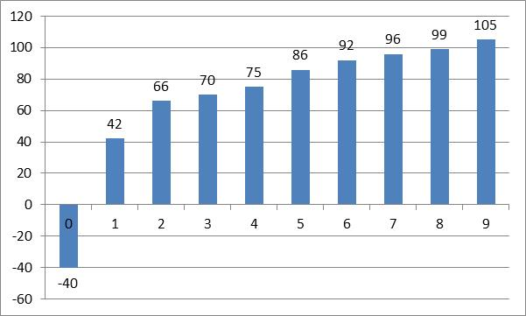
CUSTOMER LIFETIME VALUE
Profit Patterns for Credit Card Company
Year | Profit per Customer
0
1 | $42
2 | $66
3 | $70
4 | $75
5 | $86
6 | $92
7 | $96
8 | $99
9 | $105
Totals
Average Profit per Customer ($) in Cohort
Age of Customer Account (years)
Assume a 10% discount rate
What about a constant cash flow into perpetuity (i.e. an infinite planning horizon)?
Source: Reichheld and Teal, The Loyalty Effect (1997)

Slide 39
A CASH FLOW OVER AN INFINITE HORIZON
What is the Present Value?
Where d is the discount rate.
Does this suggest a way to estimate the lifetime value of a customer?
What, if any, assumptions are being made?

Slide 40
A SIMPLE VIEW OF LIFETIME VALUE
The Present Value of a Margin Received into Perpetuity
Average Profit per Customer ($) in Cohort
Constant $42 Over Infinite Horizon
Cash Flows Over Nine Years
Age of Customer Account (years)
What if we assumed the Year 1 Average Profit of $42 as the perpetuity and a 10% discount rate?
Compared to PV of actual cash flows in graph?
But what about the probability that the customer leaves?

Slide 41
CUSTOMER LIFETIME VALUE
Putting the Pieces Together: Finite Horizon
Average Profit per Customer ($) in Cohort
Retention Probability
Age of Customer Account (years)
Age of Customer Account (years)
Just the discounted cash flows adjusted by the retention probabilities

Slide 42
CUSTOMER LIFETIME VALUE
Finite Horizon, Constant Margin, Constant Retention*
Average Profit per Customer ($) in Cohort
Retention Probability
Age of Customer Account (years)
Age of Customer Account (years)
*Assuming Margin and Retention Probability are Constant at Year 1 Levels

Slide 43
CUSTOMER LIFETIME VALUE
Putting the Pieces Together: Infinite Horizon
Average Profit per Customer ($) in Cohort
Retention Probability
Age of Customer Account (years)
Age of Customer Account (years)
Simplified Formula:
Assuming Year 1 Margin and Retention into Perpetuity

Slide 44
CUSTOMER LIFETIME VALUE
What is the impact of assuming an infinite planning horizon?

Slide 45
CUSTOMER LIFETIME VALUE
Putting the Pieces Together: Infinite Horizon
Assumptions:
Constant Margin of $42 received from Year 1 into perpetuity
Constant Retention Rate of 82%
Discount Rate of 10%
What if we received a $42 margin from period 0 into perpetuity?

Slide 46
CUSTOMER LIFETIME VALUE
What About Acquisition Costs (AC)?
Average Profit per Customer ($) in Cohort
Retention Probability
Age of Customer Account (years)
Age of Customer Account (years)

Slide 47
WHAT IS THE VALUE OF A CUSTOMER?
Two Vantage Points
The finite time version
The infinite time version (assuming constant margin and retention rate!)
Net CLV is just CLV minus Acquisition Costs (AC)

Slide 48
SCORING MODELS FOR RETENTION
Key Concepts from Today
For subscription firms retention is typically observable
For non subscription firms retention must be imputed
In either case with individual customer data we can build models to predict the probability of churn or retention
The role of duration (how long have you been a customer) plays a central role
We typically expect marketing effort to also play a role
With measures of retention in hand we can examine customer lifetime value

